Slide 1
Chapter 11 Multi-Objective Optimization

Slide 2
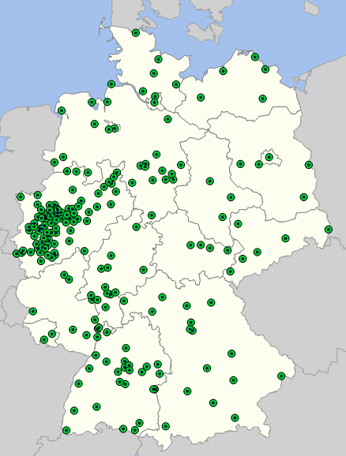
Creative Objective
Stated Objective: Minimize the number of warehouses so that all demand points are within 75km (how many do they need?)
Real Objective: Get a “reasonable” number of customers within 75km
This is multi-objective. We found that a trade-off curve worked better than using weights

Slide 3
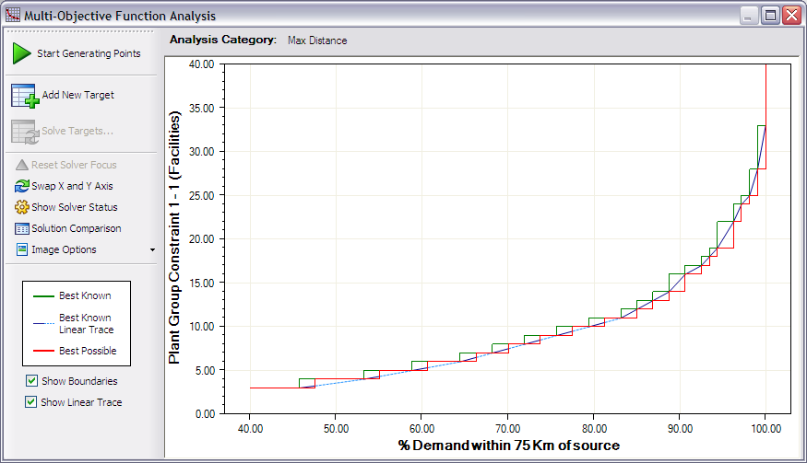
Creative Objective

Slide 4
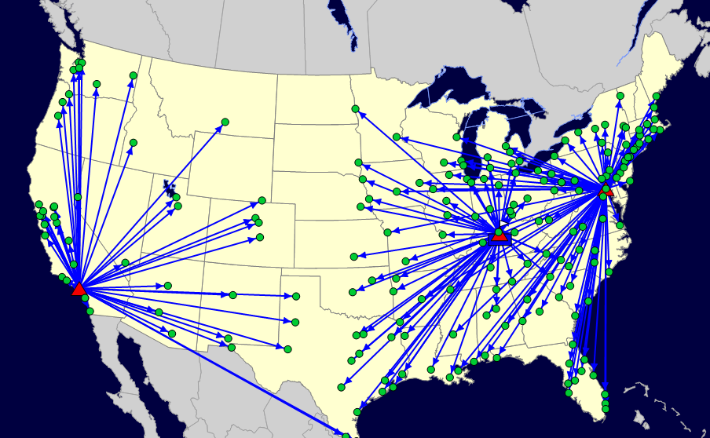
Creative Objective
Stated Objective: Minimize total costs (with lots of cost factors).

Slide 5
Creative Objective
Stated Objective: Minimize total costs (with lots of cost factors).
Why Lines Overlap
Why Lines Overlap
Optimization is looking for the lowest-cost solution, not best map
Sometimes a non-transportation cost component will dominate
Sometimes ties are broken randomly (and not the way you would want)
Sometimes you are within the optimization gaps (so the lines that cross don’t even matter)

Slide 6
Creative Objective
Stated Objective: Minimize total costs (with lots of cost factors).
Real Objective: “Hey, why do those lines overlap, we don’t want that! That doesn’t make sense!”
This is either multi-objective or hierarchical. Service does matter too!

Slide 7
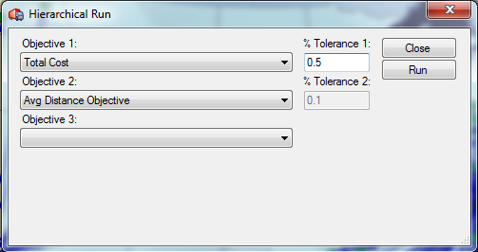
Setting up Clean-Up Models

Slide 8
Setting up Clean-Up Models
The Total Cost becomes a constraint in the 2nd Model. The tolerance gives more flexibility. It allows the cost to go up by the tolerance.

Slide 9
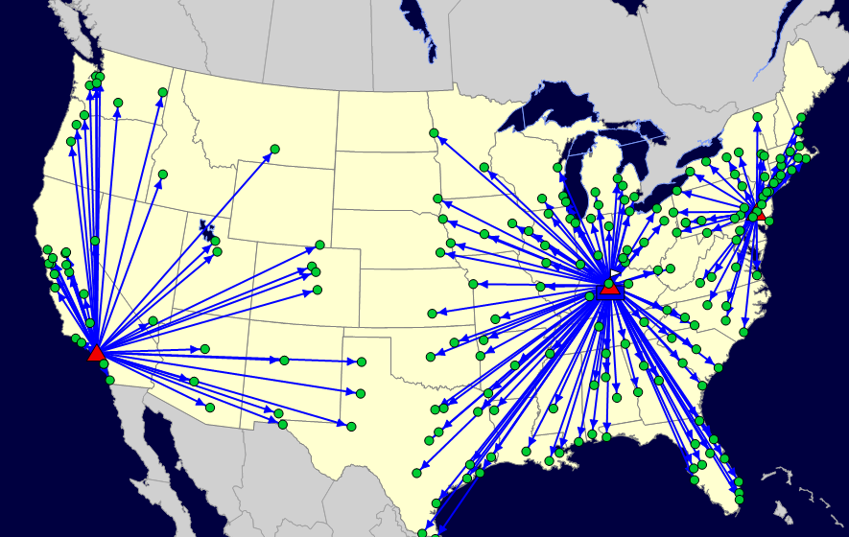
Creative Objective
Before
After (0.47% increase)
Why Use Hierarchical Optimization
Cleans up the trivial- focus on big picture
Makes solution more implementable

Slide 10
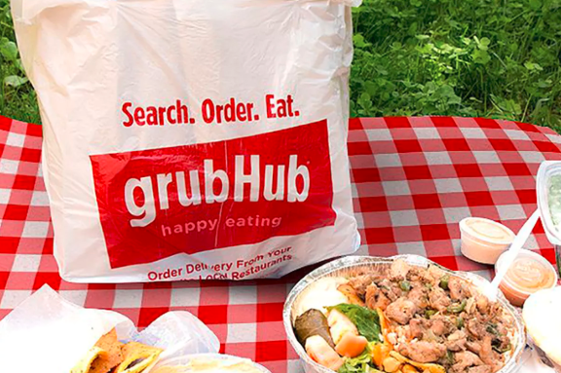
GrubHub and Hierarchical Optimization for making more logical decisions
GrubHub Has to Make Decisions at Scale
There are multiple objectives
Hierarchical optimization allows them to make trade-offs a manager would make
Give up 1% of one objective to get 10% of another, etc.

Slide 11
Let’s Generalize this… What is an efficient frontier?

Slide 12
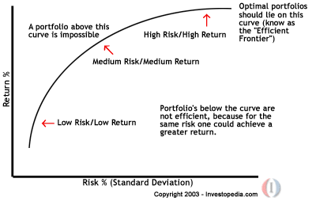
Efficient Frontier (from Finance)
http://en.wikipedia.org/wiki/Pareto_optimality

Slide 13
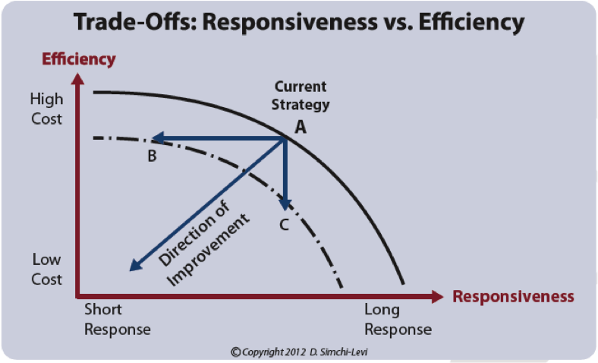
Efficient Frontier-- Operations

Slide 14
What Are Other Examples?
Ambulance
Min Avg distance
Max within 5 minutes
Minimize the maximum distance
Assignment problem for class projects
Best average
Minimize the worst assignment
Shelf Space
Max Revenue
Max Squareness/Rectangulatiry
Minimize Empty Space
Workforce Scheduling
Min Cost
Maximize desired shifts

Slide 15
These curves almost immediately provide users with insight into their trade-offs when the points start generating…. The key is to see and understand both the ‘Span’ and ‘Shape’:
What can Multi-Objective Analysis do for us?
100,000 – 110,000
100,000 – 110,000
100,000 – 110,000
VS
10,000 – 110,000
10,000 – 100,000
10,000 – 100,000
SPAN – The range of values being shown on each Axis
Insight – How much affect does the change in one variable have on change of the other?
SHAPE – The type curve produced
Insight – Diminishing Returns, Plateaus of Good Solutions, No Affect, One Point of Large Impact
Slide source: IBM

Slide 16
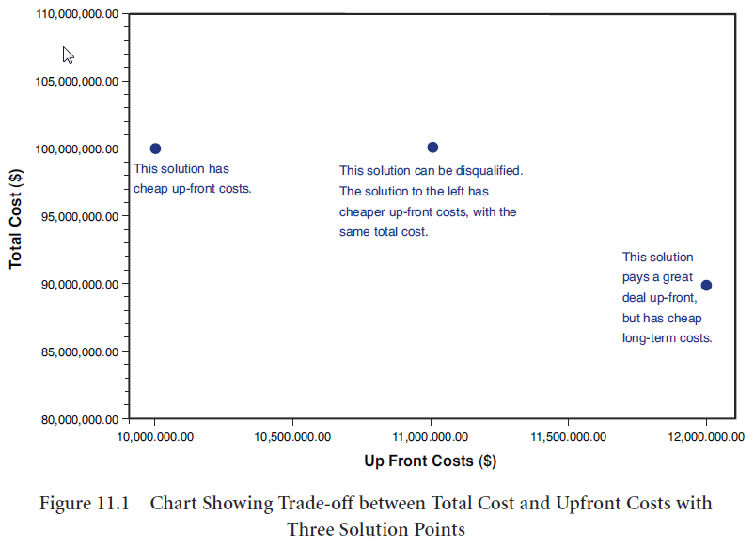
How Multi-Objective Optimization Works

Slide 17
How Multi-Objective Optimization Works

Slide 18
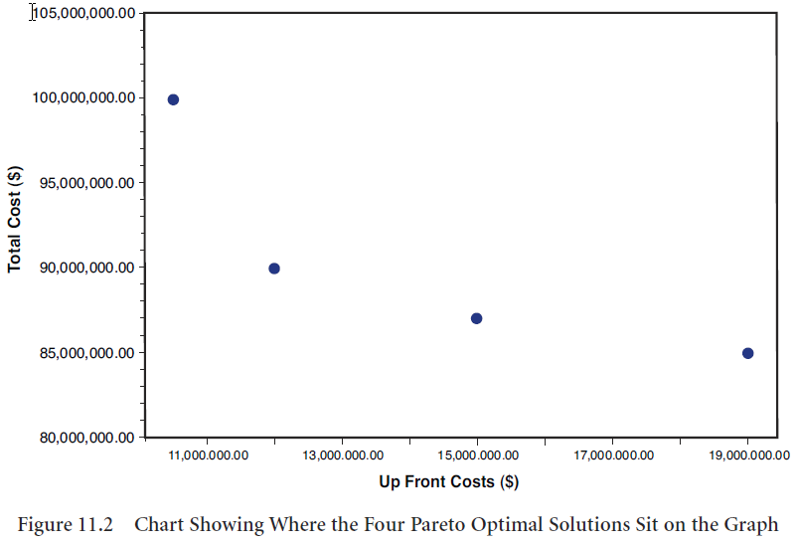
A Set Of Pareto Optimal Solutions

Slide 19
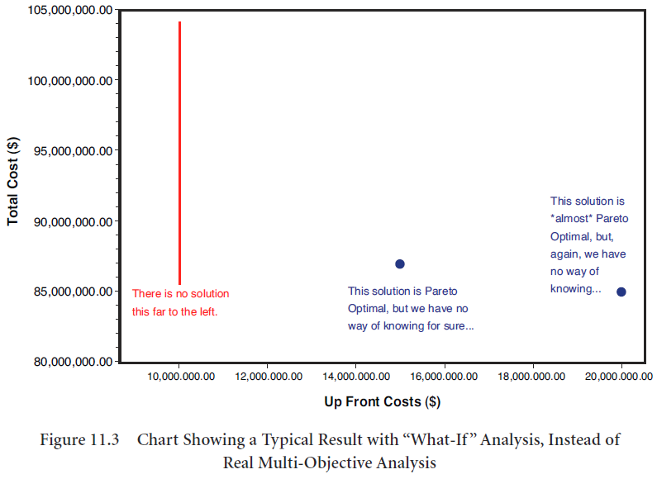
What Happens with What-If Analysis– You don’t get to fully explore the solution space

Slide 20
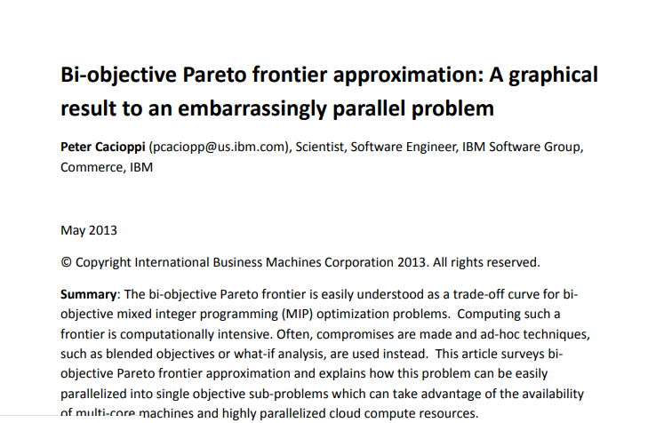
Bi-Objective Robust Way to Do and Visualize (Bi-Objective vs Multi-Objective…)

Slide 21
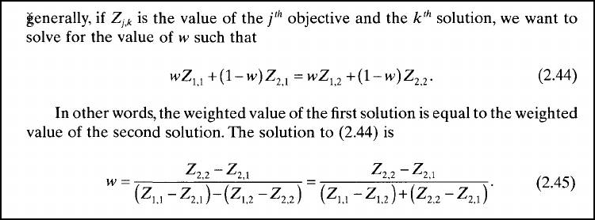
“Manual” Methods for Building the Curve: Weighted Method
Start with the two end points- weights of (1,0) and (0,1)
Now, we want to find new weights:
w is the new weight of the first objective, (1-w) the second
Source: Mark Daskin, Service Operations for Managers and Engineers

Slide 22
Hierarchical and Multi-Objective Exercises Let’s Try it Out
Hierarchical
Weighted (just to see this)
Systematically calculate the weights and next run to fill out a table like this
Brute force run multiple objectives

Slide 23
Pro’s and Con’s of Weighting Method
If you systematically pick weights
May miss some important points on the frontier
May have many extra scenarios to run
However, the weighting method can miss some non-supported solutions (see next slide)
Source: Mark Daskin, Service Operations for Managers and Engineers

Slide 24
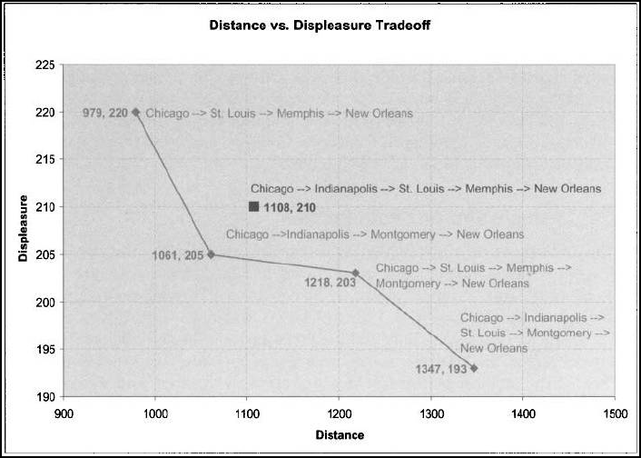
What the Weighting Method Won’t Find
Source: Mark Daskin, Service Operations for Managers and Engineers

Slide 25
How do we find Non-Supported Solutions: Constraint Method
Minimize the first objective (OBJ1) and record both results
OBJ1 and OBJ2
We then constrain the 2nd OBJ to be (OBJ2 – 1)
OBJ2 needs to be integer (or close enough to integer so you can approximate)
This forces the model to find a new solution
Proceed until no more feasible solution is found
When this stops, we are done and the answer is the best in terms of OBJ2
This approach finds all supported and non-supported solutions
What can be the drawbacks of this?
Source: Mark Daskin, Service Operations for Managers and Engineers

Slide 26
Future? / More Advanced?
Weighted and Constraint methods are a bit too much brute force
Weighted and Constraint methods can require full optimization runs
When is this a problem?
There is a lot of value in the curve of multi-objective optimization

Slide 27
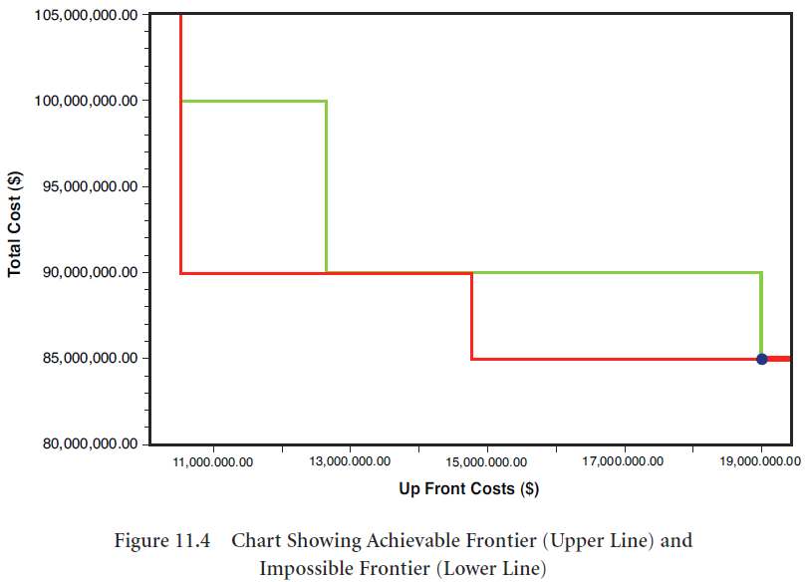
Multi-Objective Optimization Techniques for Finding the Upper and Lower Bounds Define the Solution Space

Slide 28
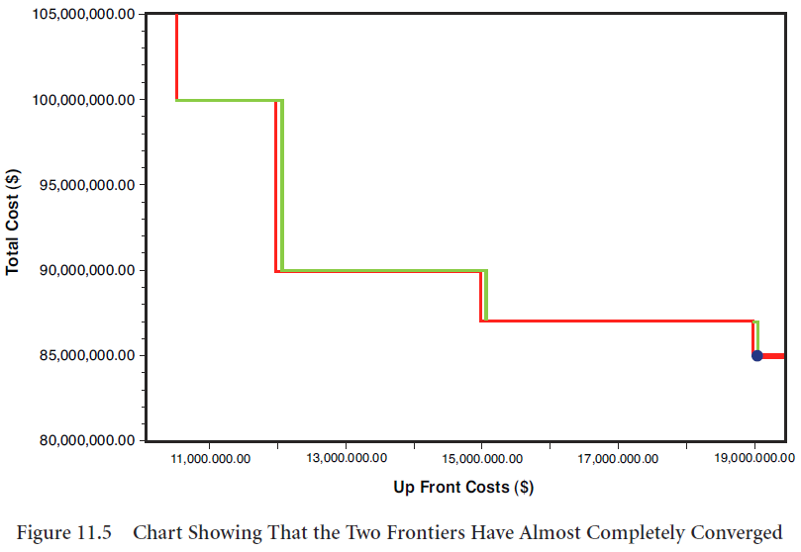
Once the Upper and Lower Bounds Converge, You Have Defined the Solution Space. This is the Trade-Off Curve

Slide 29
Summary- Lessons Learned
Multi-Objective Optimization allows you to consider multiple objectives at the same time
This technique helps us think about Pareto Optimal solution
These solutions lead to good discussion within an organization because they force you to directly confront and make decisions on trade-offs
The trade-off curve is a powerful management tool to help visualize the results

Slide 30
End of Section

